Slide 1
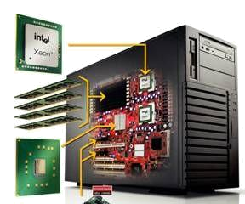
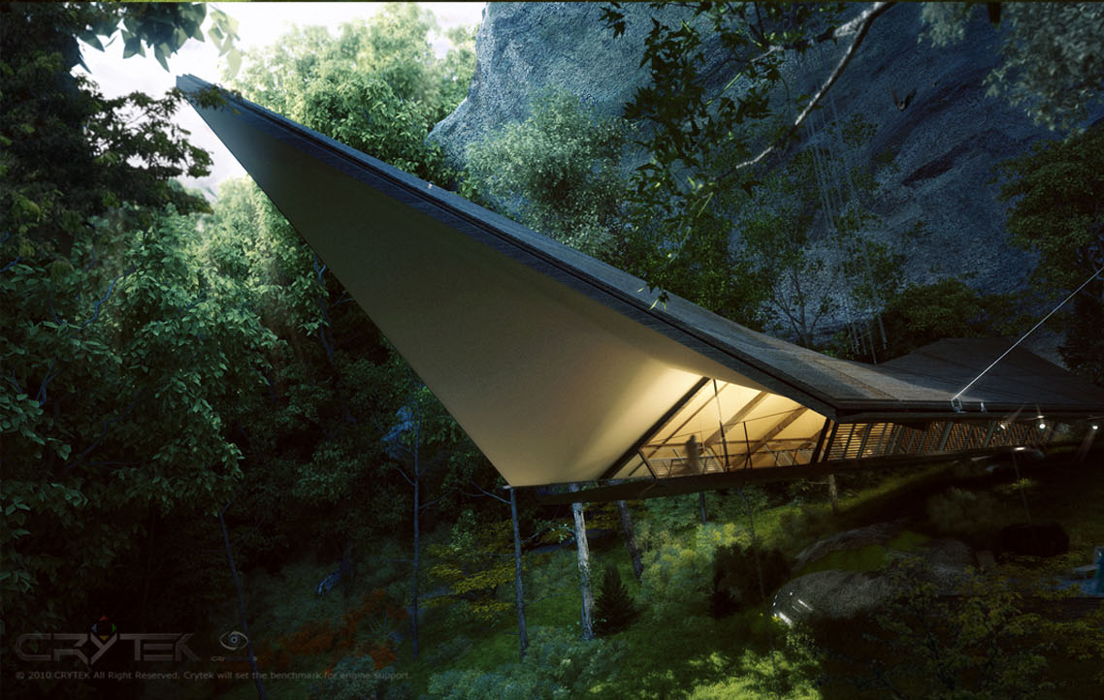
计算机高级图形学
Chapter 4 The Graphics Pipeline

Slide 2

Rendering geometric primitives
Describe objects with points, lines, and surfaces
  Compact mathematical notation
  Operators to apply to those representations
Render the objects
  The rendering pipeline

Slide 3
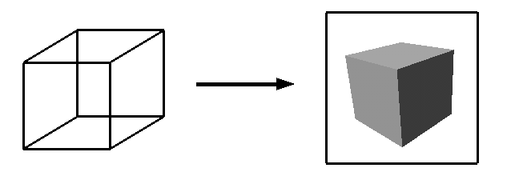
Rendering
Generate an image from geometric primitives
Rendering
Geometric Primitives
Raster Image

Slide 4
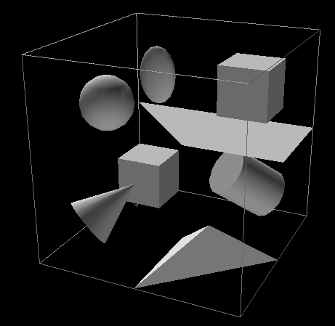
3D Rendering Example
What issues must be addressed by a
3D rendering system?

Slide 5
Take a breath
We’re done with the primitives
Now we’re moving on to study how graphics uses these primitives to make pretty pictures
Notes:
^{<number>}

Slide 6
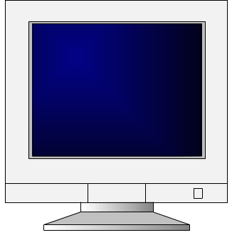

Rendering 3D Scenes
Transform
Illuminate
Transform
Clip
Project
Rasterize
Model & Camera
Parameters
Framebuffer
Display
Rendering Pipeline

Slide 7
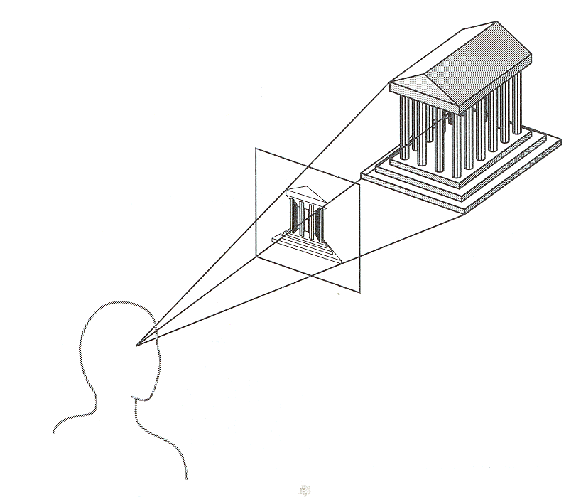
Camera Models
The most common model is pin-hole camera
  All captured light rays arrive along paths toward focal point without lens distortion
  (everything is in focus)
  Sensor response
  proportional to radiance
View plane
Other models consider ...
  Depth of field
  Motion blur
  Lens distortion
Eye position
(focal point)

Slide 8
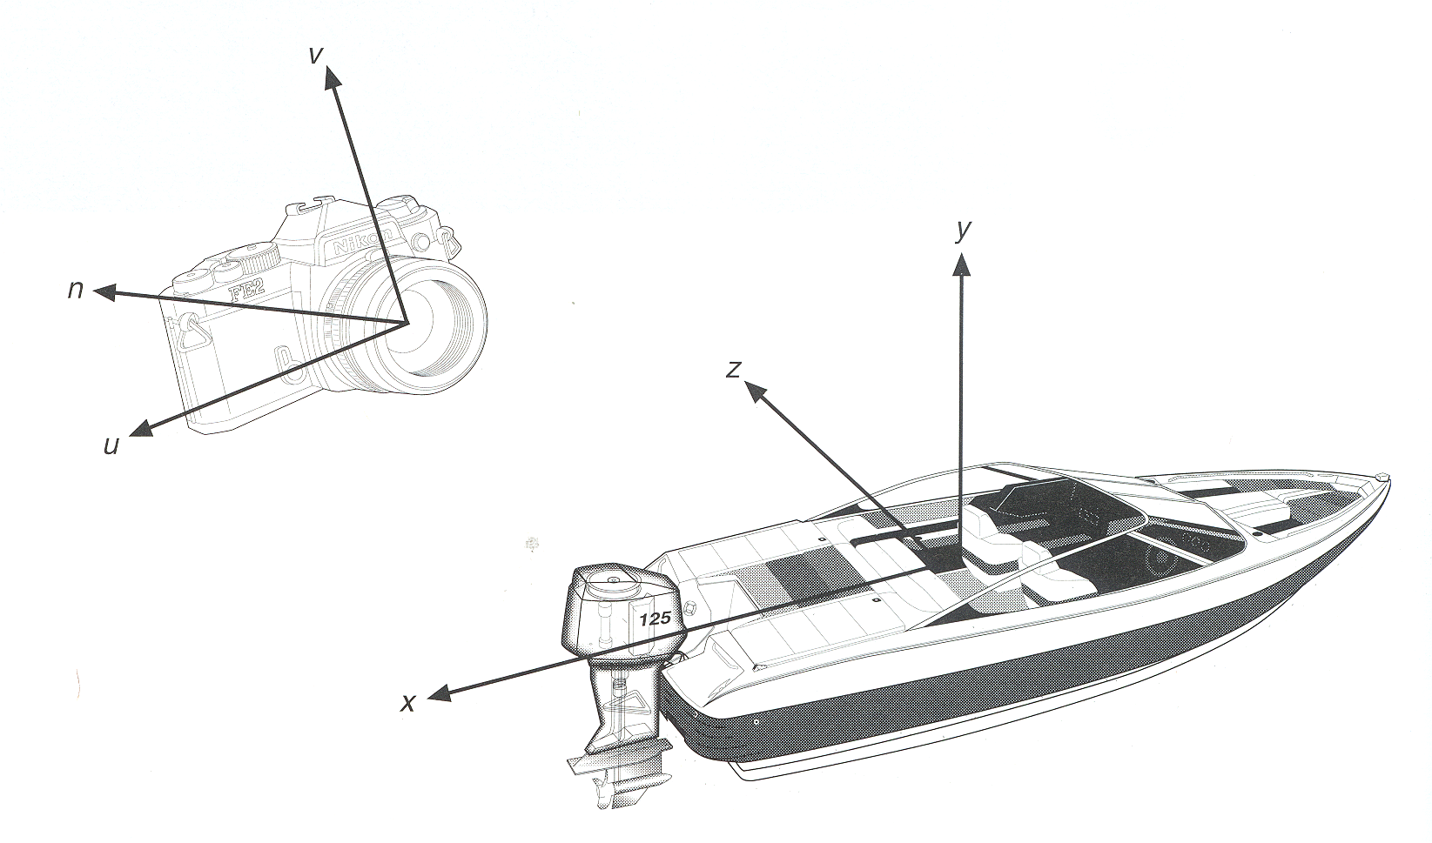
Camera Parameters
What are the parameters of a camera?

Slide 9
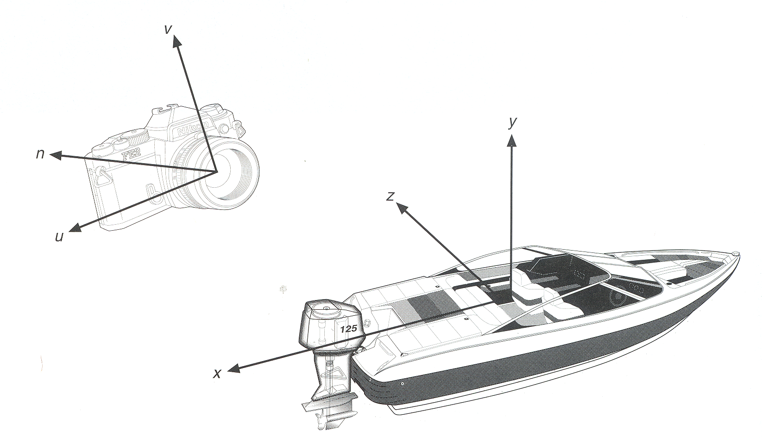
Camera Parameters
Position
  Eye position (p_{x}, p_{y}, p_{z})
Orientation
  View direction (d_{x}, d_{y}, d_{z})
  Up direction (u_{x}, u_{y}, u_{z})
Aperture
  Field of view (x_{fov}, y_{fov})
Film plane
  “Look at” point
  View plane normal
View
Plane
Up direction
“Look at”
Point
back
View direction
right
Eye
Position

Slide 10
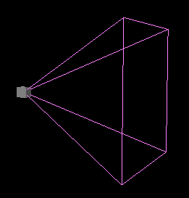
Moving the camera
Up
Back
Towards
Right
View Frustum

Slide 11
The Rendering Pipeline
Transform
Illuminate
Transform
Clip
Project
Rasterize
Model & Camera
Parameters
Rendering Pipeline
Framebuffer
Display

Slide 12
Rendering: Transformations
We’ve learned about transformations
But they are used in three ways:
  Modeling transforms
  Viewing transforms (Move the camera)
  Projection transforms (Change the type of camera)

Slide 13
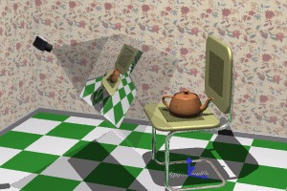
The Rendering Pipeline: 3D
Scene graph
Object geometry
Modeling
Transforms
Lighting
Calculations
Viewing
Transform
Clipping
Projection
Transform

Slide 14
The Rendering Pipeline: 3D
Scene graph
Object geometry
Result:
All vertices of scene in shared 3D “world” coordinate system
Modeling
Transforms
Modeling
Transforms
Lighting
Calculations
Viewing
Transform
Clipping
Projection
Transform

Slide 15

Rendering: Transformations
Modeling transforms
  Size, place, scale, and rotate objects and parts of the model each other
  Object coordinates -> world coordinates
Y
Z
Y
X
X
Z

Slide 16
The Rendering Pipeline: 3D
Scene graph
Object geometry
Result:
All geometric primitives are illuminated
Modeling
Transforms
Lighting
Calculations
Lighting
Calculations
Viewing
Transform
Clipping
Projection
Transform

Slide 17

Lighting Simulation
Lighting parameters
  Light source emission
  Surface reflectance
  Atmospheric attenuation
  Camera response
Light
Source
Surface
N
N
Camera

Slide 18

Lighting Simulation
Direct illumination
  Ray casting
  Polygon shading
Global illumination
  Ray tracing
  Monte Carlo methods
  Radiosity methods
Light
Source
N
Surface
N
N

Slide 19
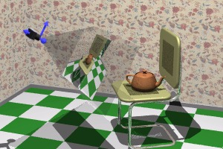
The Rendering Pipeline: 3D
Scene graph
Object geometry
Result:
Scene vertices in 3D “view” or “camera” coordinate system
Modeling
Transforms
Lighting
Calculations
Viewing
Transform
Viewing
Transform
Clipping
Projection
Transform

Slide 20

Rendering: Transformations
Viewing transform
  Rotate & translate the world to lie directly in front of the camera
    Typically place camera at origin
    Typically looking down -Z axis
  World coordinates  view coordinates

Slide 21
The Rendering Pipeline: 3D
Scene graph
Object geometry
Result:
Remove geometry that is out of view
Modeling
Transforms
Lighting
Calculations
Viewing
Transform
Clipping
Clipping
Projection
Transform

Slide 22

The Rendering Pipeline: 3D
Scene graph
Object geometry
Result:
2D screen coordinates of clipped vertices
Modeling
Transforms
Lighting
Calculations
Viewing
Transform
Clipping
Projection
Transform
Projection
Transform

Slide 23
Rendering: Transformations
Projection transform
  Apply perspective foreshortening
    Distant = small: the pinhole camera model
  View coordinates  screen coordinates

Slide 24
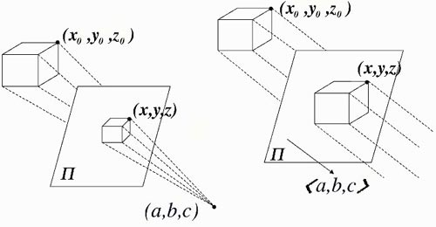
Rendering: Transformations
Perspective Camera
Orthographic Camera

Slide 25

Rendering 3D Scenes
Transform
Illuminate
Transform
Clip
Project
Rasterize
Model & Camera
Parameters
Framebuffer
Rendering Pipeline
Display

Slide 26
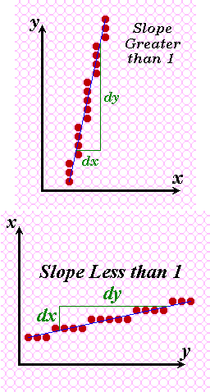
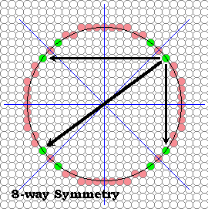
Rasterize
Convert screen coordinates to pixel colors

Slide 27
Classic Rendering Pipeline
3D Geometric Primitives
Modeling
Transformation
Transform into 3D world coordinate system
Illuminate according to lighting and reflectance
Lighting
Viewing
Transformation
Transform into 3D camera coordinate system
Projection
Transformation
Transform into 2D screen coordinate system
Clipping
Clip primitives outside camera’s view
Scan
Conversion
Draw pixels (includes texturing, hidden surface, ...)
Image
Notes:
顶点 -> 图元 -> 片元
图元（primitives）：场景里面的物体都是由很多组primitives组成的，primitive包括point, line, triangles。
片元（fragment）：二维图象上每个点都包含了颜色、深度和纹理数据。将该点和相关信息叫做一个片元（fragment）。
^{<number>}

Slide 28

Classic Rendering Pipeline
3D Geometric Primitives
What’s wrong with this model (for an OpenGL system)?
  Model/view transforms combined
  Really “vertices” not “primitives”
    Making this the vertex pipeline
Modeling
Transformation
Lighting
Viewing
Transformation
Projection
Transformation
Clipping
Scan
Conversion
Image

Slide 29
Classic Rendering Pipeline
  There’s a lot going on in the “scan conversion” stage!
    Primitive assembly
    Rasterization
    Texture mapping
    Per-pixel lighting
    Visibility (Z-buffer)
  We refer to these collectively as the pixel or fragment pipeline
3D Geometric Primitives
Modeling
Transformation
Lighting
Viewing
Transformation
Projection
Transformation
Clipping
Scan
Conversion
Image

Slide 30

High-Level Pipeline
Back up & think about the larger
CPU
GPU
Application
Processing
Geometry
Processing
Rasterization
  What sort of tasks does each stage perform?

Slide 31
High-Level Pipeline
Application | Geometry (“vertex pipeline”) | Rasterization ( “pixel pipeline” or “fragment pipeline”)
Handle input | Transform | Rasterize (fill pixels)
Simulation & AI | Lighting | Interpolate vertex parameters
 |  | Look up/filter textures
Culling | Skinning | Z- and stencil tests
LOD selection | Calculate texture coords | Blending
Prefetching

Slide 32
Graphics Pipeline: CPU
SIMUlATION
CULL
DRAW
DISPLAY

Slide 33

Graphics Pipeline: GPU
CPU
Graphics State
GPU
Application
Vertex
Processor
Assembly
& Rasterization
Pixel
Processor
Video
Memory
(Textures)
Final
pixels
(Color, Depth)
Xformed,
Lit
Vertices(2D)
Fragments
(pre-pixels)
Vertices
(3D)
Render-to-texture
Note:
  Vertex processor does all transform and lighting
  Pipe widths vary
    Intra-GPU pipes wider than CPU→GPU pipe
    Thin GPU→CPU pipe
  Many caches and FIFOs not shown
  Soon: render-to-vertex-array

Slide 34
Graphics Pipeline: GPU
CPU
Graphics State
GPU
Vertex
Processor
Pixel
Processor
Application
Vertex
Processor
Assembly
& Rasterization
Pixel
Processor
Video
Memory
(Textures)
Final
pixels
(Color, Depth)
Xformed,
Lit
Vertices(2D)
Fragments
(pre-pixels)
Vertices
(3D)
Render-to-texture
  Here’s what’s cool:
    Can now program vertex processor!
    Can now program pixel processor!

Slide 35
Possible Bottlenecks
CPU
transfer
transform
raster
texture
fragment
frame
buffer
CPU
Geometry Storage
Geometry Processor
Rasterizer
Fragment Processor
Framebuffer
Texture Storage + Filtering
CPU/Bus
Bound
Vertex Bound
Pixel Bound
Notes:
^{<number>}

